Slide 1
CSE 161 – Design and Architecture of Computer Systems
Chapter 1
Computer Abstractions and Technology

Slide 2
what you will learn
How programs are translated into the machine language
And how the hardware executes them
The hardware/software interface
What determines program performance
And how it can be improved
How hardware designers improve performance
What is parallel processing

Slide 3
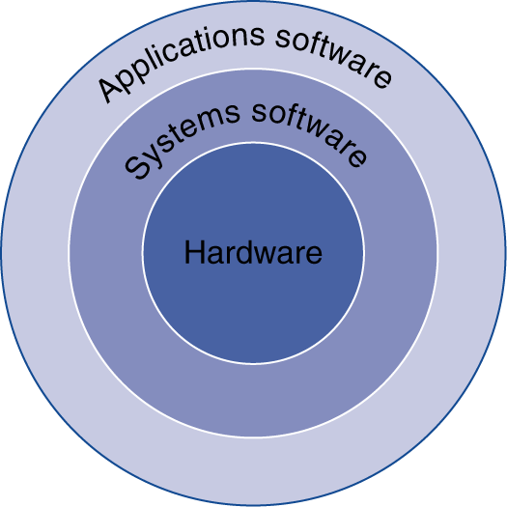
below your program
Application software
Written in high-level language
System software
Compiler: translates HLL code to machine code
Operating System: service code
Handling input/output
Managing memory and storage
Scheduling tasks & sharing resources
Hardware
Processor, memory, I/O controllers

Slide 4
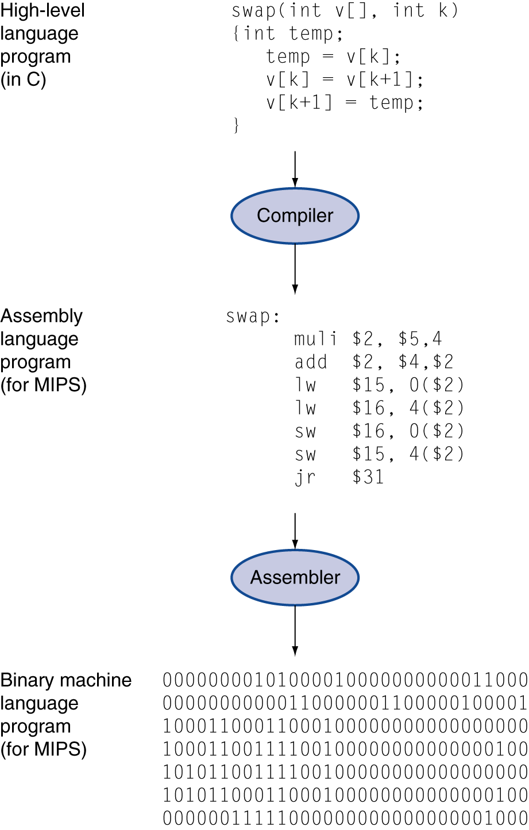
levels of program code
High-level language
Level of abstraction closer to problem domain
Provides for productivity and portability
Assembly language
Textual representation of instructions
Hardware representation
Binary digits (bits)
Encoded instructions and data

Slide 5
inside the processor (CPU)
Datapath: performs operations on data
Control: sequences datapath, memory, ...
Cache memory
Small fast SRAM memory for immediate access to data

Slide 6
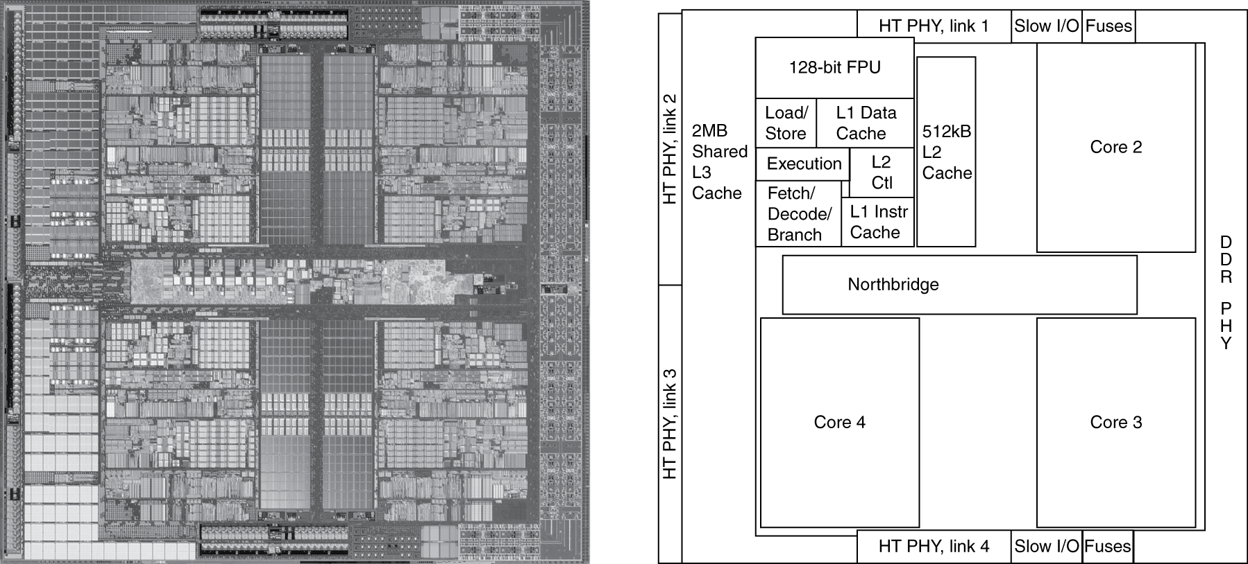
Inside the Processor
AMD Barcelona: 4 processor cores

Slide 7
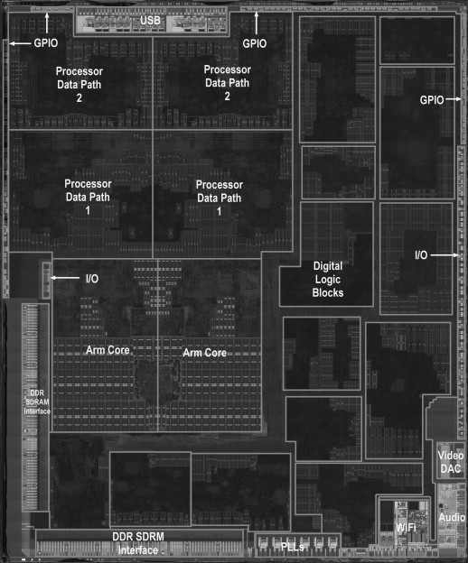
Inside the A5 package

Slide 8
understanding performance
Algorithm
Determines number of operations executed
Programming language, compiler, architecture
Determine number of machine instructions executed per operation
Processor and memory system
Determine how fast instructions are executed
I/O system (including OS)
Determines how fast I/O operations are executed

Slide 9

law of processor performance
algorithm
language
compiler
ISA
ISA
μarch
μarch
technology

Slide 10
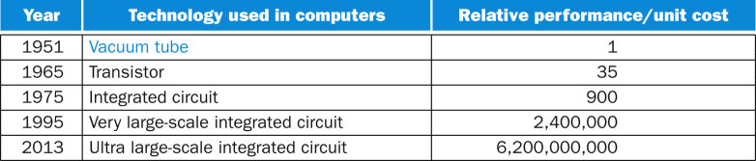
how fast is it getting faster?
6.2 10⁹ in 62 years, the growth rate is = ?
36.37%

Slide 11
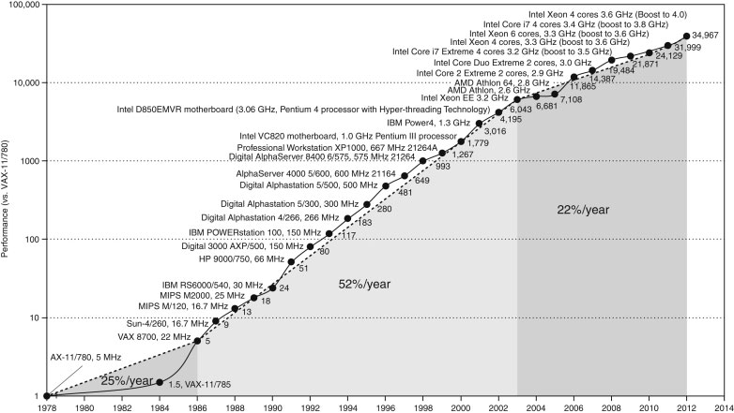
unicore performance
Constrained by power, instruction-level parallelism, memory latency

Slide 12
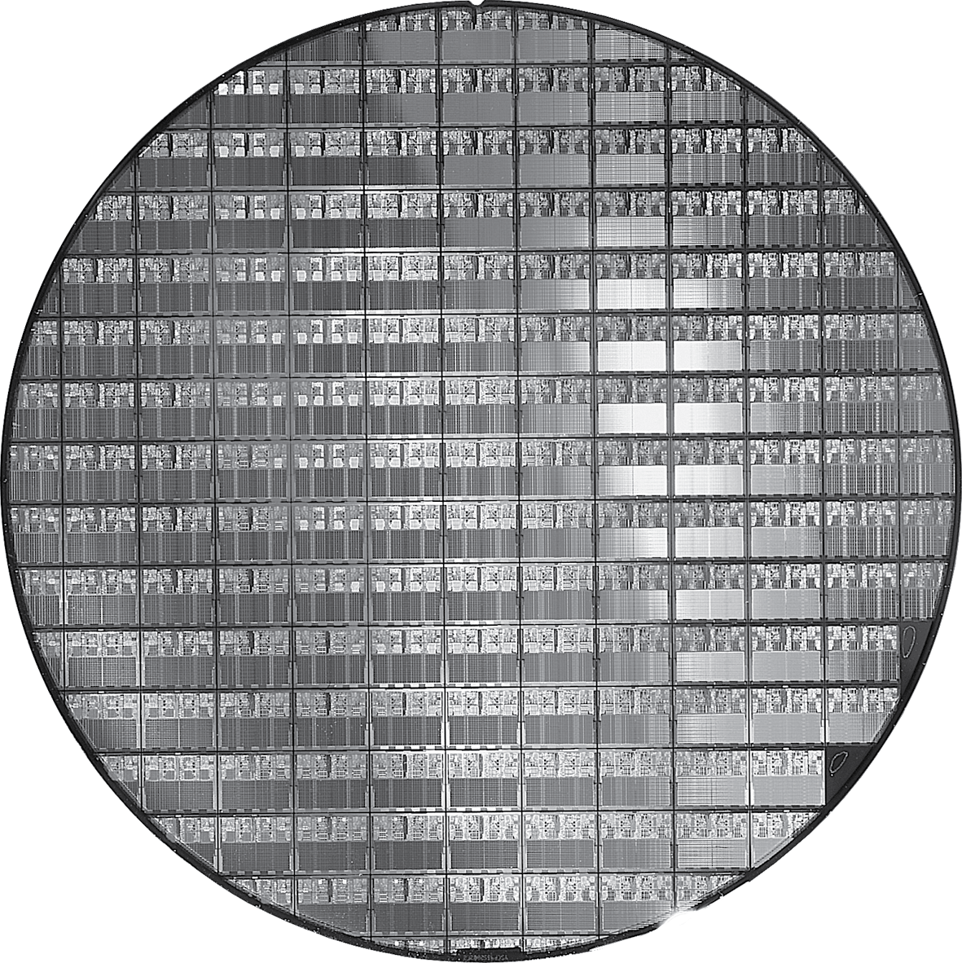
AMD Opteron X2 wafer
X2: 300mm wafer, 117 chips, 90nm technology
X4: 45nm technology

Slide 13
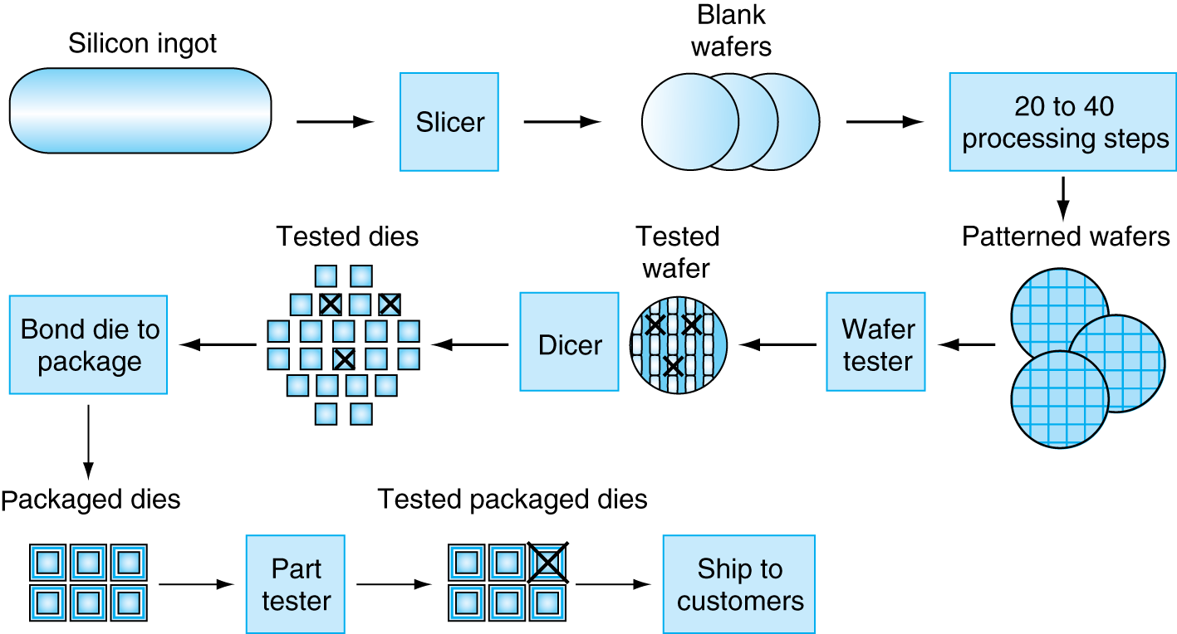
manufacturing ICs
Yield: proportion of working dies per wafer

Slide 14
abstractions
Abstraction helps us deal with complexity
Hide lower-level detail
Instruction set architecture (ISA)
The hardware/software interface
Application binary interface
The ISA plus system software interface
Implementation
The details underlying and interface

Slide 15
Defining Performance
Which airplane has the best performance?

Slide 16
response time & throughput
Response time
How long it takes to do a task
Throughput
Total work done per unit time
e.g., tasks/transactions/… per hour
How are response time and throughput affected by
Replacing the processor with a faster version?
Adding more processors?
We’ll focus on response time for now…

Slide 17
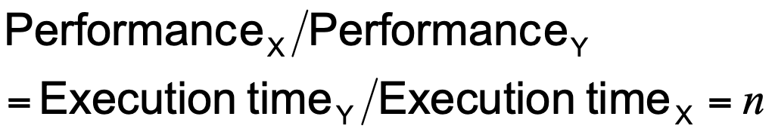
relative performance
Define Performance = 1/Execution Time
“X is n time faster than Y”
Example: time taken to run a program
10s on A, 15s on B
Execution Time_{B} / Execution Time_{A} = 15s / 10s = 1.5
So A is 1.5 times faster than B

Slide 18
measuring execution time
Elapsed time
Total response time, including all aspects
Processing, I/O, OS overhead, idle time
Determines system performance
CPU time
Time spent processing a given job
Discounts I/O time, other jobs’ shares
Comprises user CPU time and system CPU time
Different programs are affected differently by CPU and system performance

Slide 19
CPU clocking
Operation of digital hardware governed by a constant-rate clock
Clock period
Clock (cycles)
Data transfer and computation
Update state
Clock period: duration of a clock cycle
e.g., 250ps = 0.25ns = 250×10^{–12}s
Clock frequency (rate): cycles per second
e.g., 4.0GHz = 4000MHz = 4.0×10⁹Hz

Slide 20
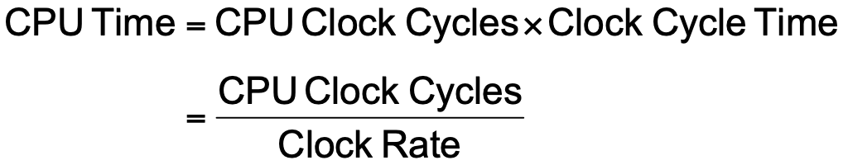
CPU time
Performance improved by
Reducing number of clock cycles
Increasing clock rate
Hardware designer must often trade off clock rate against cycle count

Slide 21
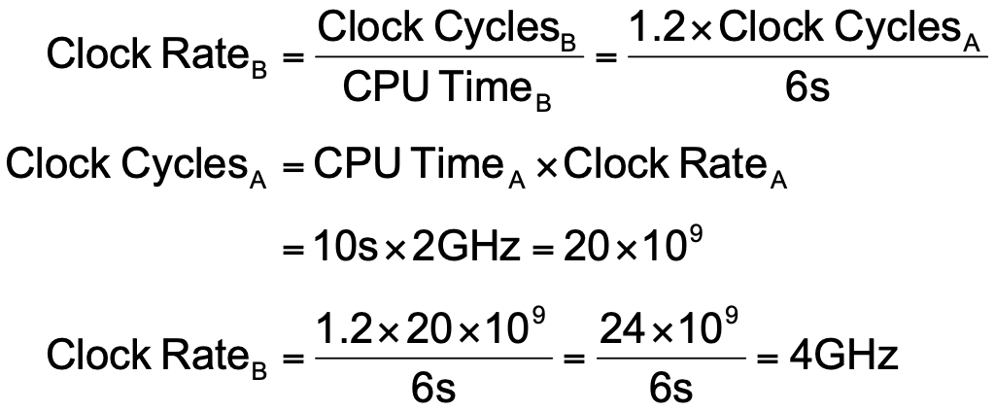
CPU time example
Computer A: 2GHz clock, 10s CPU time
Designing Computer B
Aim for 6s CPU time
Can do faster clock, but causes 1.2 × clock cycles
How fast must Computer B clock be?

Slide 22
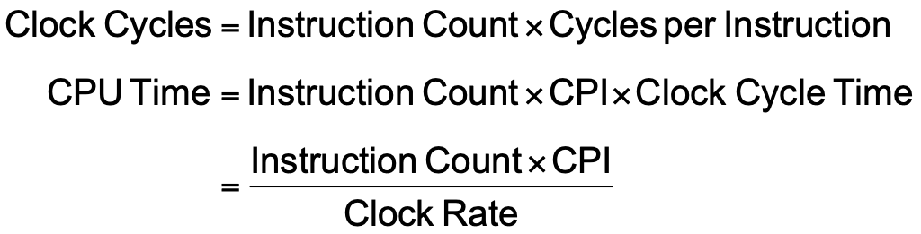
instruction count and CPI
Instruction Count for a program
Determined by program, ISA and compiler
Average cycles per instruction
Determined by CPU hardware
If different instructions have different CPI
Average CPI affected by instruction mix

Slide 23
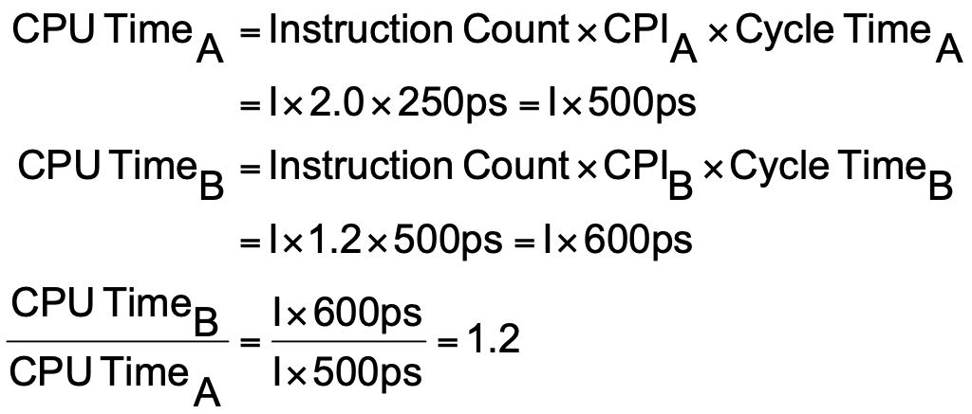
CPI example
Computer A: Cycle Time = 250ps, CPI = 2.0
Computer B: Cycle Time = 500ps, CPI = 1.2
Same ISA
Which is faster, and by how much?
A is faster…
…by this much

Slide 24
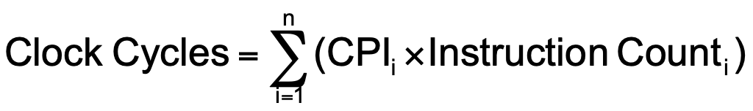
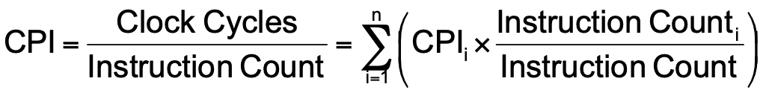
CPI in more details
If different instruction classes take different numbers of cycles
Weighted average CPI
Relative frequency

Slide 25
CPI example
Alternative compiled code sequences using instructions in classes A, B, C
Class | A | B | C
CPI for class | 1 | 2 | 3
IC in sequence 1 | 2 | 1 | 2
IC in sequence 2 | 4 | 1 | 1
Sequence 1: IC = 5
Clock Cycles = 2×1 + 1×2 + 2×3 = 10
Avg. CPI = 10/5 = 2.0
Sequence 2: IC = 6
Clock Cycles = 4×1 + 1×2 + 1×3 = 9
Avg. CPI = 9/6 = 1.5

Slide 26
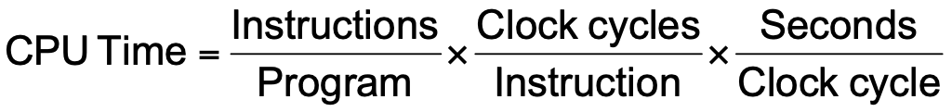
performance summary
Performance depends on
Algorithm: affects IC, possibly CPI
Programming language: affects IC, CPI
Compiler: affects IC, CPI
Instruction set architecture: affects IC, CPI, T_{c}

Slide 27
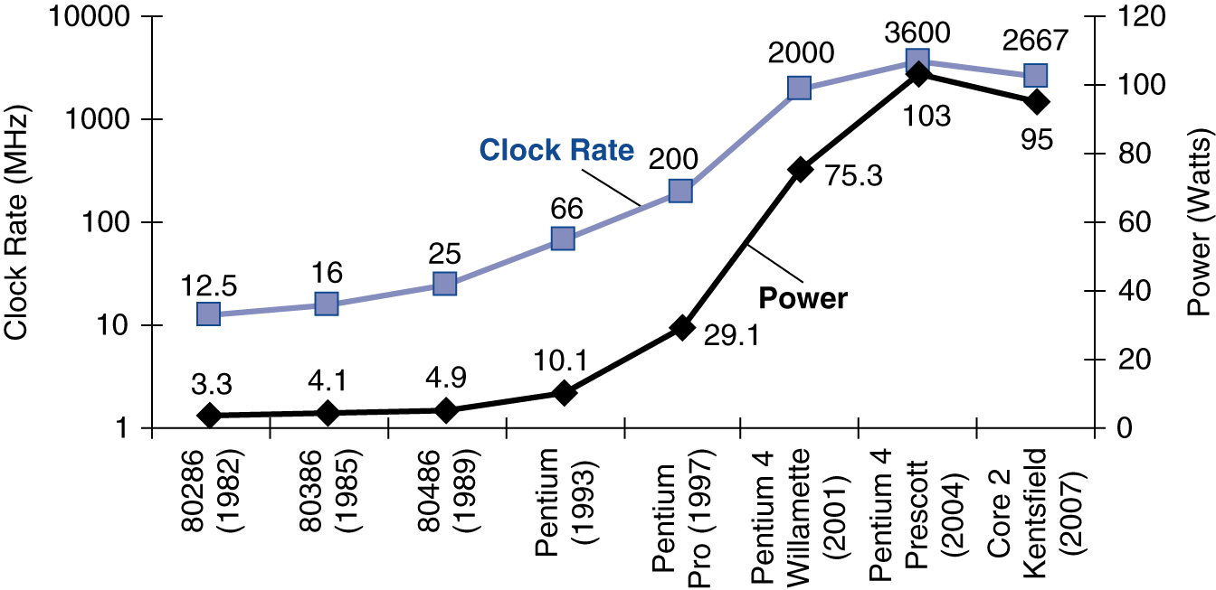
power trends
In CMOS IC technology
×30
5V → 1V
×1000

Slide 28
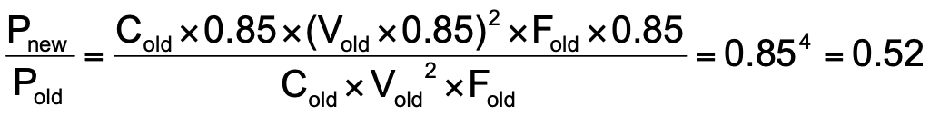
reducing power
Suppose a new CPU has
85% of capacitive load of old CPU
15% voltage and 15% frequency reduction
The power wall
We can’t reduce voltage further
We can’t remove more heat
How else can we improve performance?

Slide 29
multiprocessors
Multicore microprocessors
More than one processor per chip
Requires explicitly parallel programming
Compare with instruction level parallelism
Hardware executes multiple instructions at once
Hidden from the programmer
Hard to do
Programming for performance
Load balancing
Optimizing communication and synchronization

Slide 30
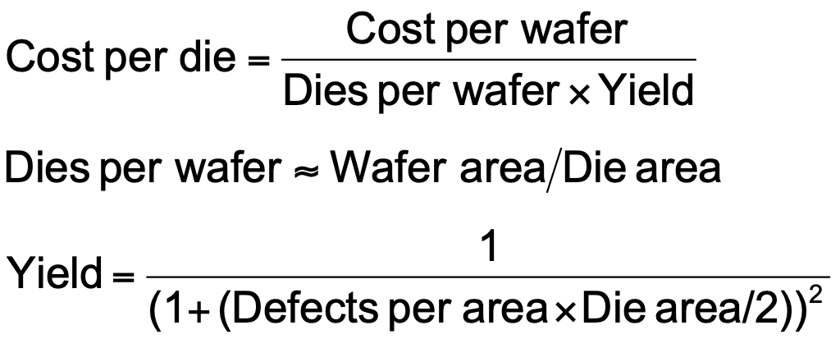
Integrated Circuit Cost
Nonlinear relation to area and defect rate
Wafer cost and area are fixed
Defect rate determined by manufacturing process
Die area determined by architecture and circuit design

Slide 31
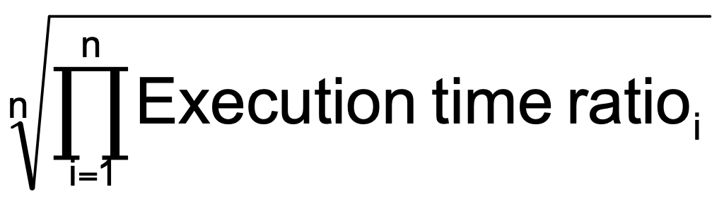
SPEC CPU Benchmark
Programs used to measure performance
Supposedly typical of actual workload
Standard Performance Evaluation Corp (SPEC)
Develops benchmarks for CPU, I/O, Web, …
SPEC CPU2006
Elapsed time to execute a selection of programs
Negligible I/O, so focuses on CPU performance
Normalize relative to reference machine
Summarize as geometric mean of performance ratios
CINT2006 (integer) and CFP2006 (floating-point)

Slide 32
CINT2006 for Opteron X4 2356
Name | Description | IC×10⁹ | CPI | Tc (ns) | Exec time | Ref time | SPECratio
perl | Interpreted string processing | 2,118 | 0.75 | 0.40 | 637 | 9,777 | 15.3
bzip2 | Block-sorting compression | 2,389 | 0.85 | 0.40 | 817 | 9,650 | 11.8
gcc | GNU C Compiler | 1,050 | 1.72 | 0.47 | 24 | 8,050 | 11.1
mcf | Combinatorial optimization | 336 | 10.00 | 0.40 | 1,345 | 9,120 | 6.8
go | Go game (AI) | 1,658 | 1.09 | 0.40 | 721 | 10,490 | 14.6
hmmer | Search gene sequence | 2,783 | 0.80 | 0.40 | 890 | 9,330 | 10.5
sjeng | Chess game (AI) | 2,176 | 0.96 | 0.48 | 37 | 12,100 | 14.5
libquantum | Quantum computer simulation | 1,623 | 1.61 | 0.40 | 1,047 | 20,720 | 19.8
h264avc | Video compression | 3,102 | 0.80 | 0.40 | 993 | 22,130 | 22.3
omnetpp | Discrete event simulation | 587 | 2.94 | 0.40 | 690 | 6,250 | 9.1
astar | Games/path finding | 1,082 | 1.79 | 0.40 | 773 | 7,020 | 9.1
xalancbmk | XML parsing | 1,058 | 2.70 | 0.40 | 1,143 | 6,900 | 6.0
Geometric mean |  |  |  |  |  |  | 11.7
High cache miss rates

Slide 33
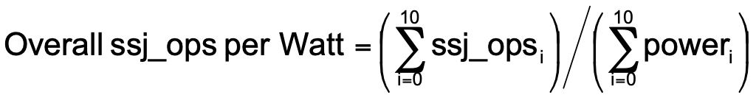
SPEC Power Benchmark
Power consumption of server at different workload levels
Performance: ssj_ops/sec
Power: Watts (Joules/sec)

Slide 34
SPECpower_ssj2008 for X4
Target Load % |  | Performance (ssj_ops/sec) |  | Average Power (Watts)
100% |  | 231,867 |  | 295
90% |  | 211,282 |  | 286
80% |  | 185,803 |  | 275
70% |  | 163,427 |  | 265
60% |  | 140,160 |  | 256
50% |  | 118,324 |  | 246
40% |  | 920,35 |  | 233
30% |  | 70,500 |  | 222
20% |  | 47,126 |  | 206
10% |  | 23,066 |  | 180
0% |  | 0 |  | 141
Overall sum |  | 1,283,590 |  | 2,605
∑ssj_ops/ ∑power |  |  |  | 493

Slide 35

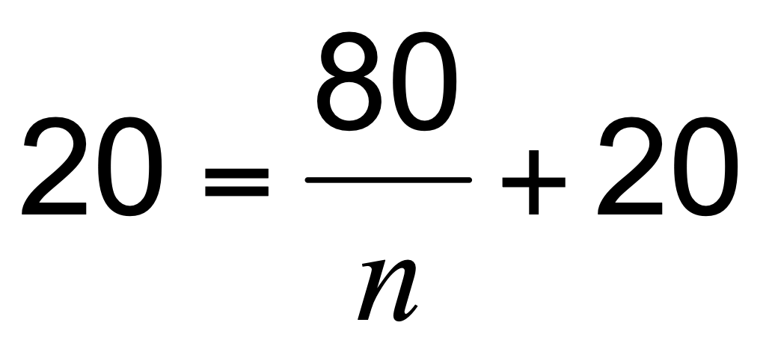
Pitfall: Amdahl’s law
Improving an aspect of a computer and expecting a proportional improvement in overall performance
Example: multiply accounts for 80s/100s
How much improvement in multiply performance to get 5× overall?
Can’t be done!
Corollary: make the common case fast

Slide 36
Fallacy: low power at idle
Look back at X4 power benchmark
At 100% load: 295W
At 50% load: 246W (83%)
At 10% load: 180W (61%)
Google data center
Mostly operates at 10% – 50% load
At 100% load less than 1% of the time
Consider designing processors to make power proportional to load

Slide 37
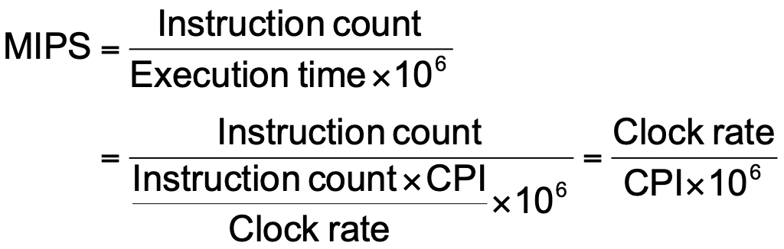
Pitfall: MIPS as a performance metric
MIPS: Millions of Instructions Per Second
Doesn’t account for
Differences in ISAs between computers
Differences in complexity between instructions
CPI varies between programs on a given CPU

Slide 38
concluding remarks
Cost/performance is improving
Due to underlying technology development
Hierarchical layers of abstraction
In both hardware and software
Instruction set architecture
The hardware/software interface
Execution time: the best performance measure
Power is a limiting factor
Use parallelism to improve performance

